Slide 1
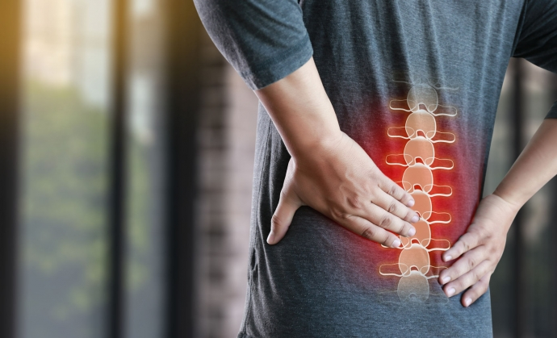
Lower Back Pain
A crippling burden in today’s society

Slide 2

Peter Le
Data scientist, Medical scientist, Chiropractor
Education:
Master’s degree in Chiropractic
Bachelor’s degree in Chiropractic Science
Bachelor’s degree of Medical Science
Main area of Interest and experience:
Experienced clinical practitioner specializing in clinical diagnosis, treatment, and prevention strategies of spinal biomechanical disorders
Previous research into effectiveness of shoulder orthopaedic testing
Passionate in increasing awareness and utilization of allied health services

Slide 3

It’s more than just a heavy load on the back
Lower back pain is the leading cause of disability globally
It is rapidly increasing to increase due to ageing and obesity
It reduces Australia’s GDP by $3.2 billion per year
The number one condition keeping older Australians out of work
Australia spends over $4.8 billion per year on LBP management
https://www.monash.edu/medicine/news/latest/2018-articles/global-burden-of-low-back-pain-a-consequence-of-medical-negligence-and-misinformation

Slide 4

What are we going wrong?
“The challenge is getting the right care at the right time”
LBP is poorly understood and mismanaged medically
Waste of financial and medical resources
Most research is focused on:
Measuring the efficacy of specific treatment modalities
Diagnostics using expensive imaging technology which may not be financially justified
https://www.monash.edu/medicine/news/latest/2018-articles/global-burden-of-low-back-pain-a-consequence-of-medical-negligence-and-misinformation

Slide 5

We need you
Medical doctors
Free resources and improve patient outcome by referring to more specialised healthcare professionals
Health insurance companies
Identify patients at risk of injury for occupational and health protection, and underwriting
Health policymakers
Assist in allocating resources to identifying LBP to reduce GDP loss due to disability
Allied healthcare professionals
Increased utilisation of their services and be the primary point of contact

Slide 6
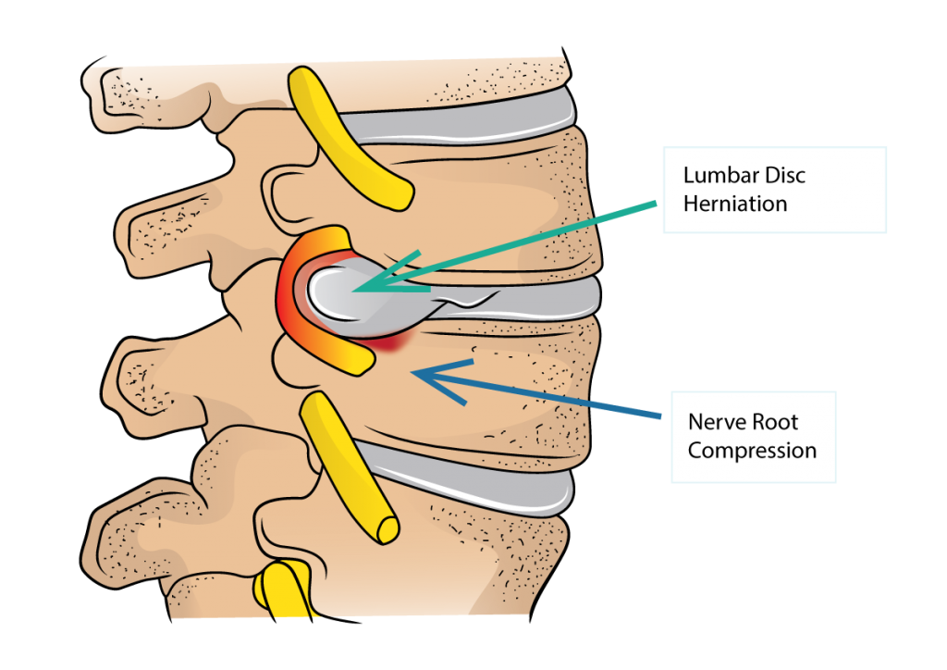
LBP characteristics
Generally categorised as acute or chronic LBP
Acute: last several days, resolve on its own, minimal loss of function after
Chronic: continues for over 12 weeks, even after initial injury is treated
Most LBP is mechanical in nature
Involves pathology of muscles, ligaments, bones, disc, or nerves
Disc herniation
The tough outer annular layer is compromised, the inner nucleus protrudes under compression
Causes neuropathic pain such as sciatica
Spondylolisthesis
Backward or forward displacement of vertebrae
Usually due to fractured pars interarticularis
https://drleespine.com.au/lumbar-disc-herniation-and-sciatica/
Notes:
Acute = several days to several weeks, can resolve on its own, and full function is usually restored after a while
Chronic continues for 12 weeks or longer, and persist even after the injured tissue is not physically compromised. Chronic LBP doesn’t mean it’s a serious issue
Most LBP is mechanical in nature, which will be a very relevant point later on.
Muscles get strained, ligaments get sprained, bones can narrow openings, discs can herniate, and nerves can get irritated or compressed
Disc hernation: Discs sit in between each spinal vertebrae and they act as shock absorbers. When the outer annular ring is compromised, the squishy inner layer can protrude out to compress surrounding spinal nerves
Spondylolisthesis: Forward or backward shift of vertebrae. Usually due to a cracked pars inter-articularis – the bridge structure that connects the front to the back of the vertabrae

Slide 7
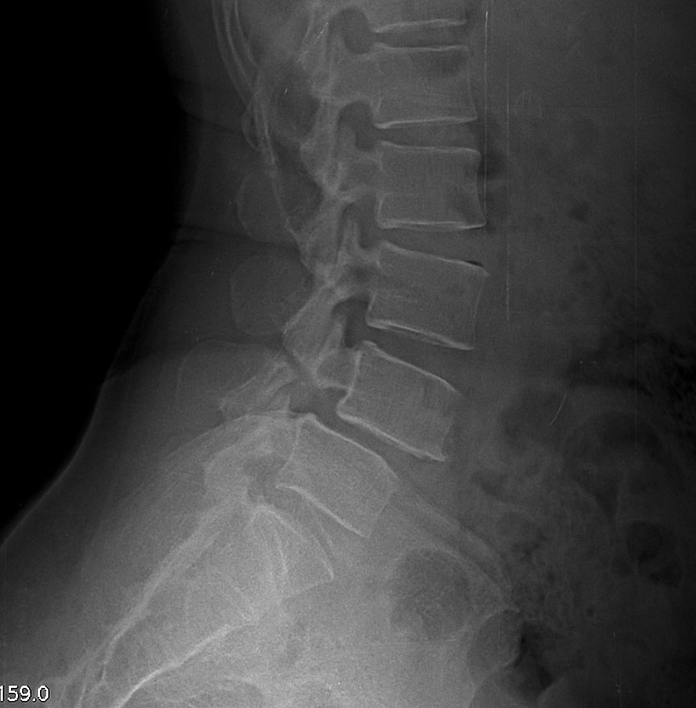
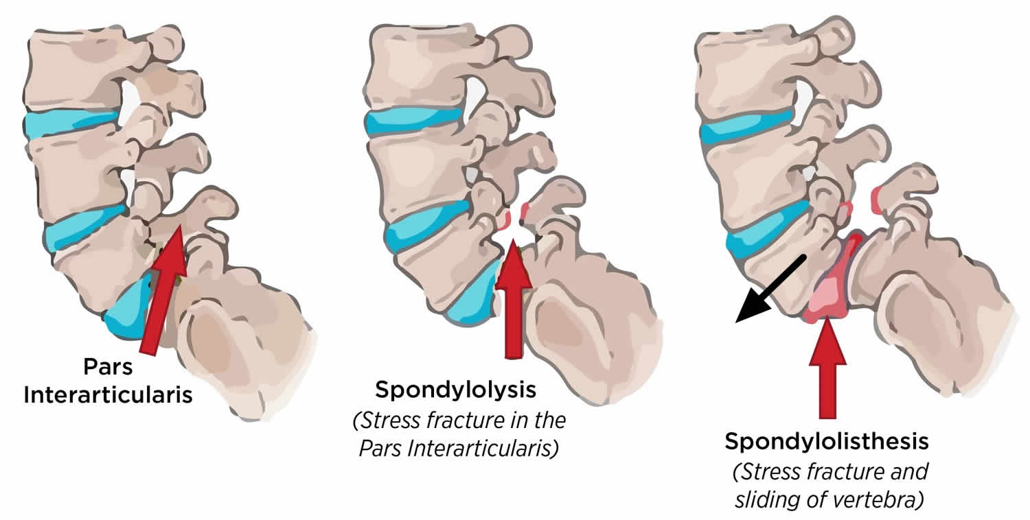
Spondylolisthesis
At risk of spinal instability
https://healthjade.net/spondylolysis
https://radiopaedia.org/cases/pars-interarticularis-defect

Slide 8

How can we help?
How can we use a model that utilizes low-cost imaging to identify patients at risk of disc herniation or spondylolisthesis?
What’s the benefit of answering this question?
Average net-benefit of treating LBP with physiotherapy
$6,063 per episode of care
Gain $32,155 Quality-Adjusted Life-Year
Current Australian guidance is $215,875
$750-$988 million dollars currently being spent on chiropractic care, especially for back and neck pain
Treatment is similarly effective as physiotherapy
Model will assist GP’s and other parties to identify when to refer to other professional health care providers
Offset burden and cost on public health system
“A workforce survey of Australian chiropractic: the profile and practice features of a nationally representative sample of 2,005 chiropractors”, Adams et al (2017)
“ Value of Physiotherapy in Australia”, Australian Physiotherapy Association (2020)

Slide 9
How can data help us?
Spinal imaging data
Exploratory Data Analysis
Data Pre-processing
Modelling
Conclusion and Application
Which spinal structural parameters can we use to identify patients at risk of disc herniation or spondylolisthesis?

Slide 10
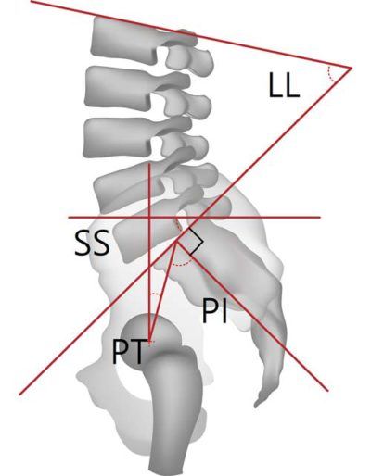
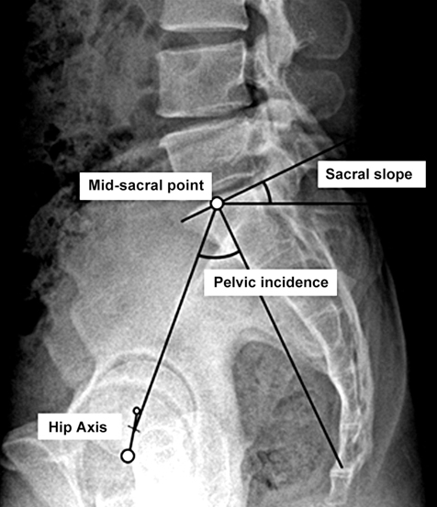
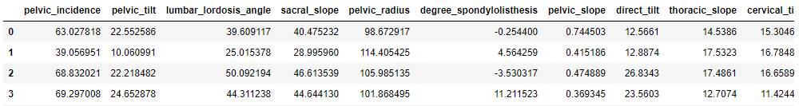
Dataset
310 observations with 13 columns
Measurement of specific spinal biomechanical attributes derived from the shape and orientation of the lumbar spine and pelvis
Pelvic incidence and tilt, sacral slope, pelvic radius, lumbar lordosis, etc.
Classified as normal or abnormal (risk of disc hernia and spondylolisthesis)
Sourced from https://archive.ics.uci.edu/ml/datasets/Vertebral+Column

Slide 11
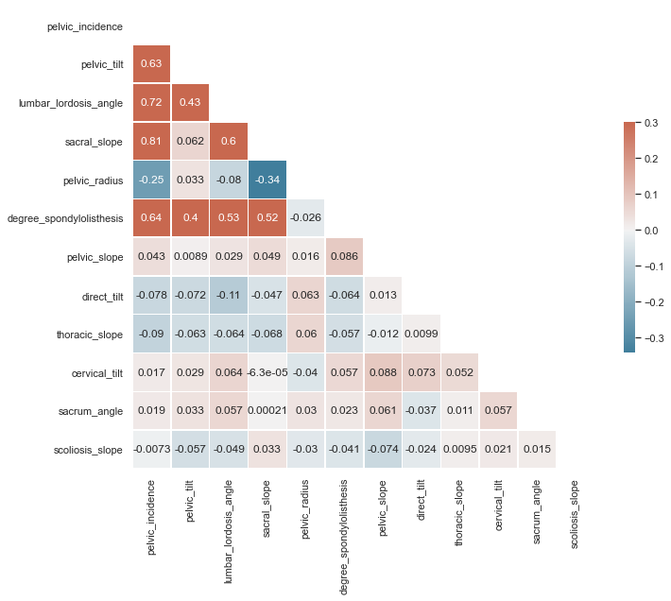
What patterns did we find?
Key findings:
Noticeable correlation between pelvic incidence and:
Lumbar lordosis angle
Pelvic tilt
Sacral slope
Degree spondylolisthesis may be more dependent on:
Pelvic incidence
Pelvic tilt
Sacral slope
Lumbar lordosis angle
This suggests targeting these two parameters may yield more effective treatment outcomes

Slide 12
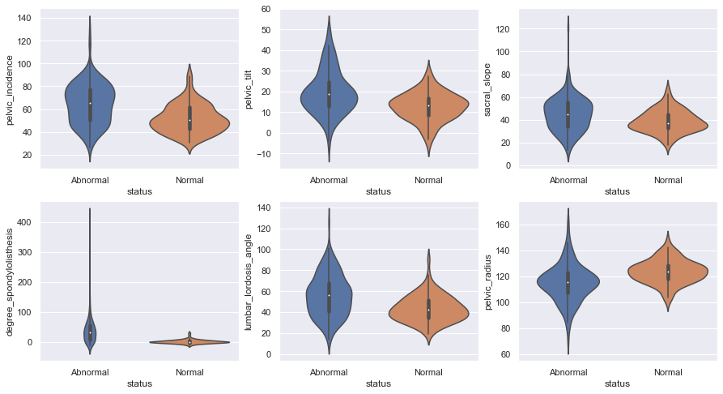
How does it contribute to disc herniation and spondylolisthesis?
Key findings:
Those at risk of disc herniation and spondylolisthesis generally tend to have a higher:
Pelvic incidence
Pelvic tilt
Lumbar lordosis angle
Pelvic radius

Slide 13
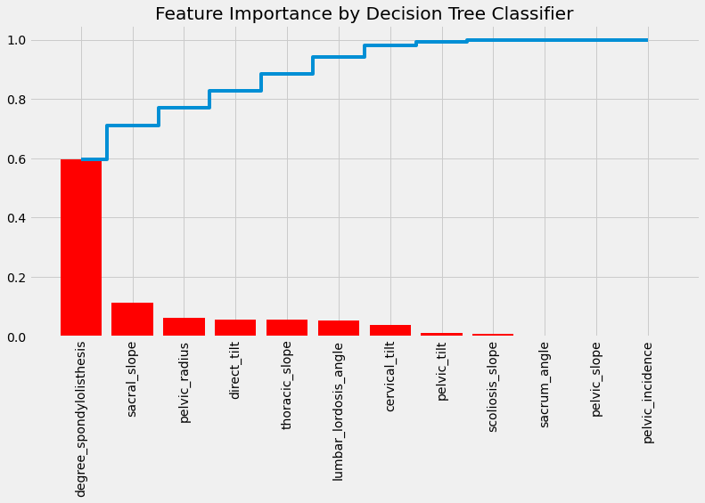
Modeling and Feature Importance
Model | Accuracy | After Cross- validation
Support Vector Machine | 0.74 | 0.74
Gradient Boosting | 0.78 | 0.73
Random Forest | 0.83 | 0.74
Logistic Regression | 0.87 | 0.78

Slide 14
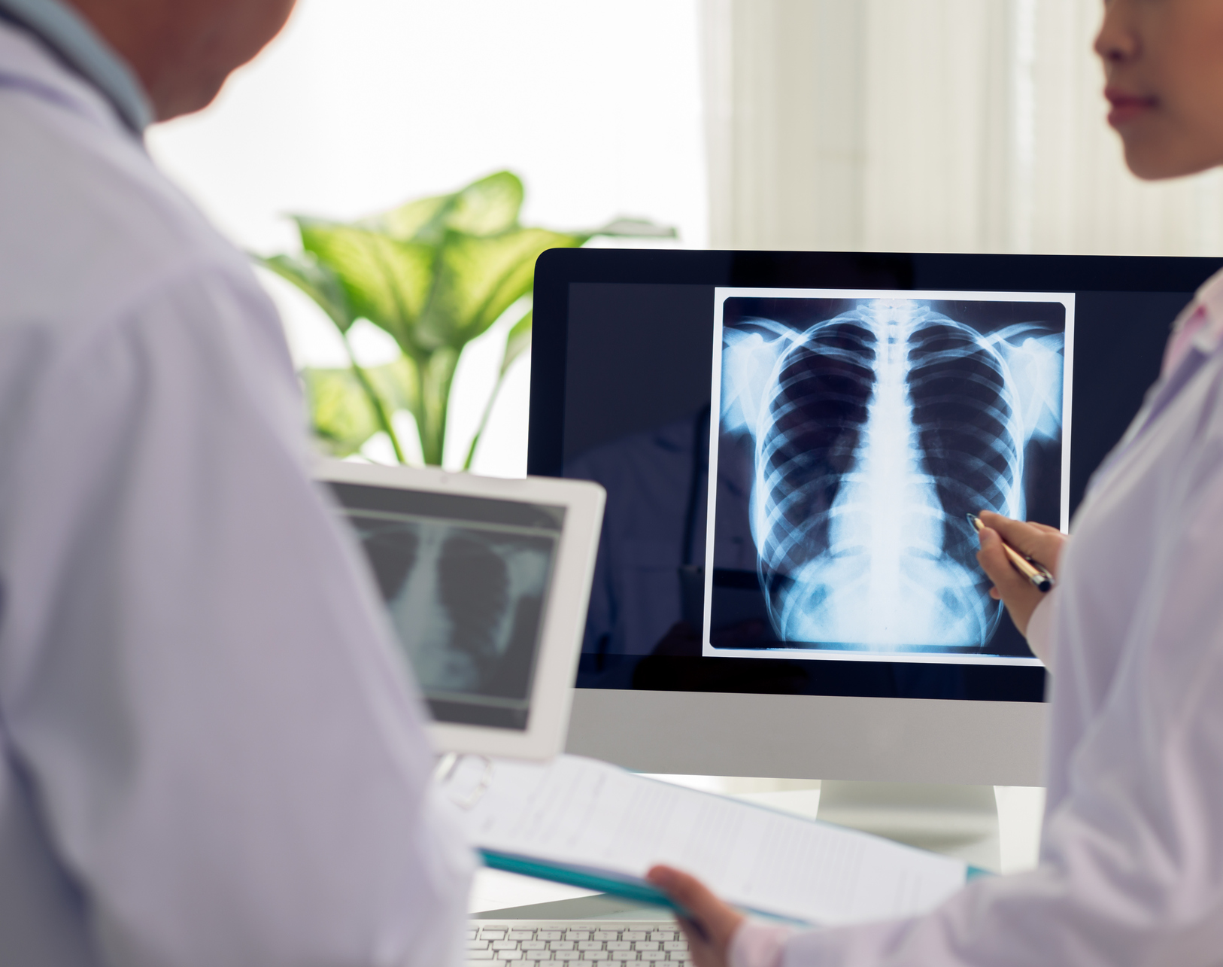
How can we use this?
Once imaging data is obtained, modelling is used to identify patients at risk of disc herniation and spondylolisthesis
Those at risk can then be referred to the appropriate healthcare provider to optimize health outcomes

Slide 15

Future Recommendations and Conclusion
By having the confidence to refer to the right treatment at the right time
Significantly offset the financial burden on our public health systems
Physiotherapy can reduce financial loss by up to 6x compared to government standards
Further improvements and ideas
Collect more observational data with additional variables
Limitations
Requires X-ray imaging that needs measurement
Look into computer vision technology to automate this process

Slide 16

Thank you

